Slide 1
10 Years of Cacti
and the Evolution of Plugins
Larry ‘TheWitness’ Adams
[ thewitness@cacti.net ]

Slide 2
Agenda
What is Cacti?
The Origins of Cacti
The Classic Network Operations Model
Introducing the Plugin Architecture
Useful Plugins by Example
The Current State of Cacti
The Future of Cacti
Questions and Answers

Slide 3
What is Cacti?
Cacti is the complete frontend to RRDTool!
It stores all of the necessary information to create graphs and populate them with data in a MySQL database.
The frontend is completely PHP driven.
Along with being able to maintain Graphs, Data Sources, and Round Robin Archives in a database, Cacti handles the data gathering.
There is also SNMP support for those used to creating traffic graphs with MRTG.
Source: www.cacti.net

Slide 4
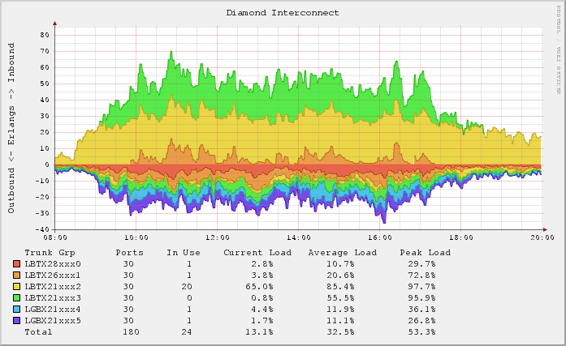
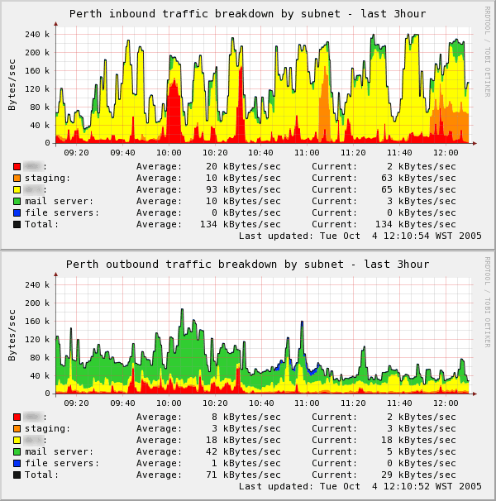
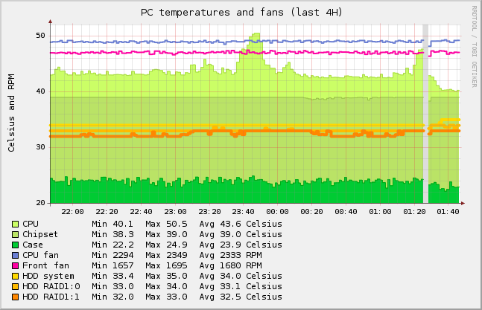
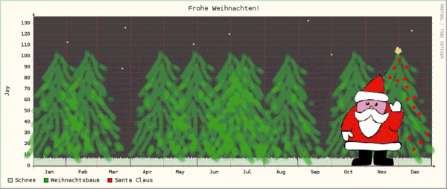
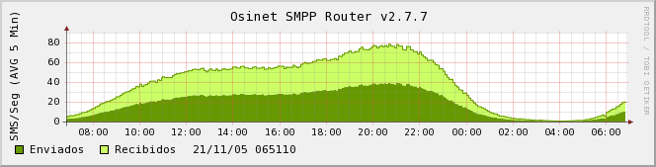
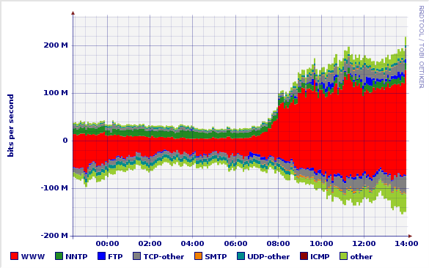
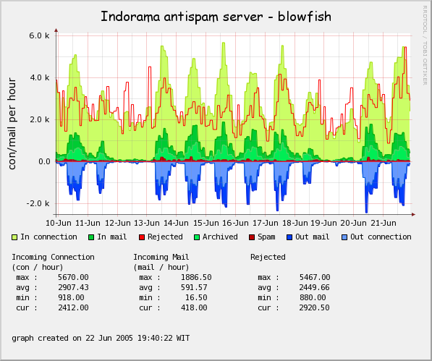
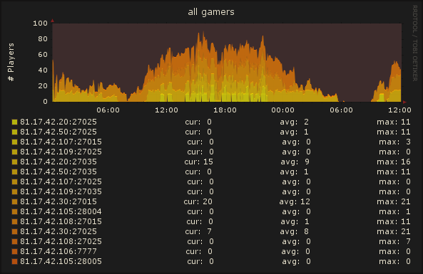
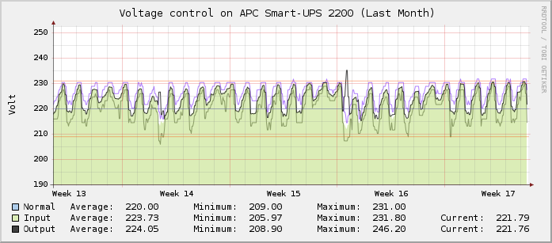
Graphs You Say….

Slide 5
The Origins of Cacti
Started by Ian Berry in 2001 while he was in high school
Published as a ‘free’ Application on rrdtool.org Website
Discovered by many while in search for a replacement for … you name it
Several ink-u-Berry releases and new developers through 2004
Widespread global use began after the release of 0.8.6 in the summer of 2004

Slide 6
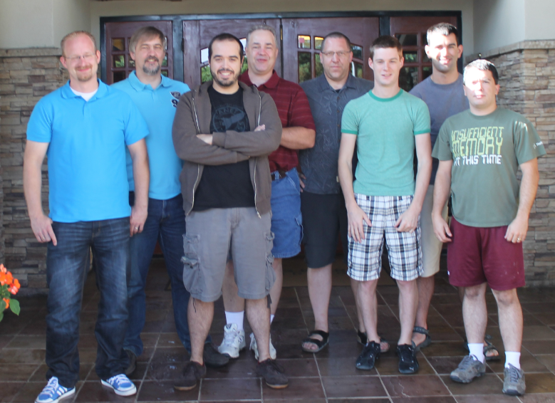
The Current Cacti Group – August 2011
gandalf
TheWitness
LineGod
BSOD2600
browniebraun
rony
raX
cigamit

Slide 7
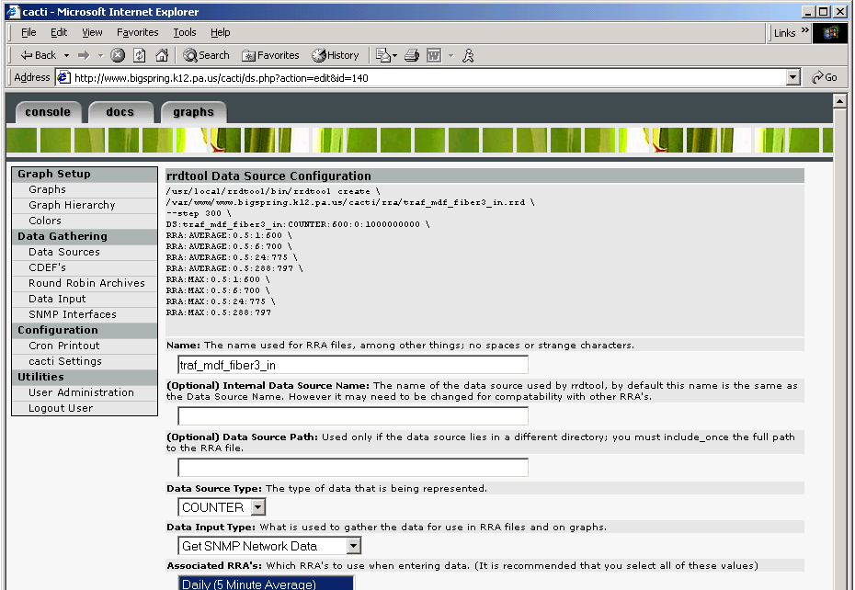
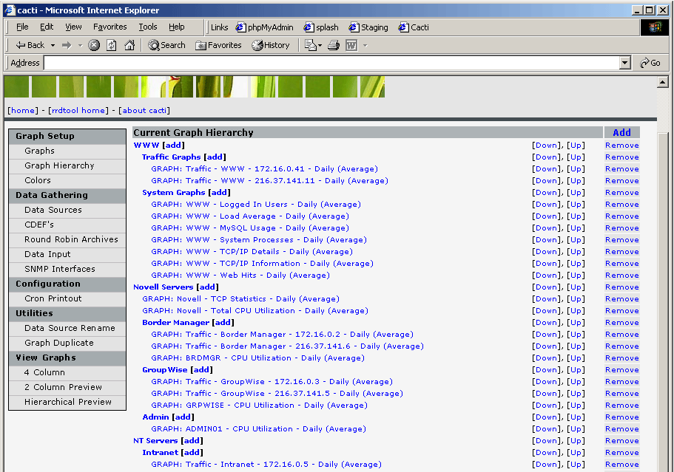
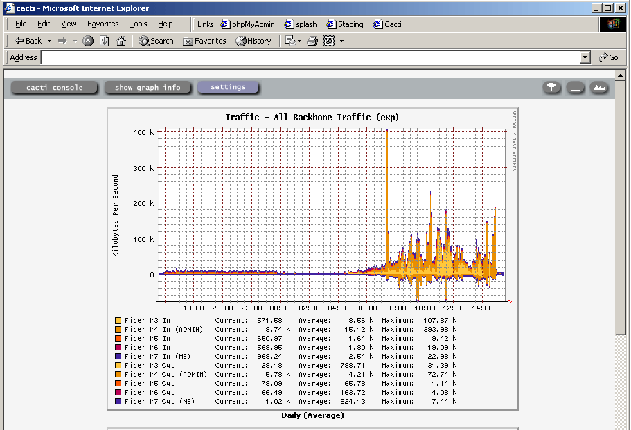
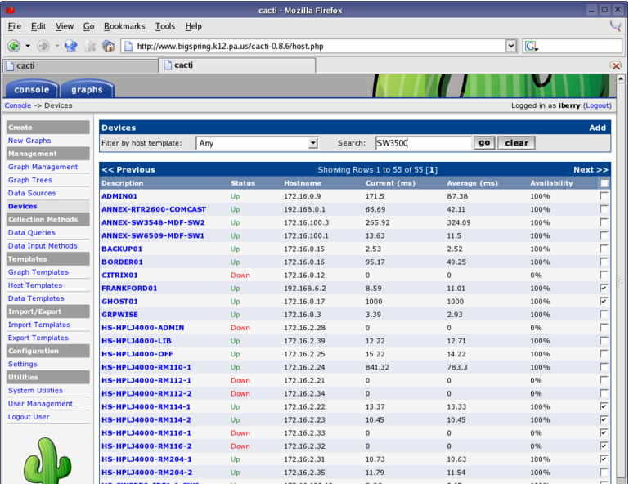
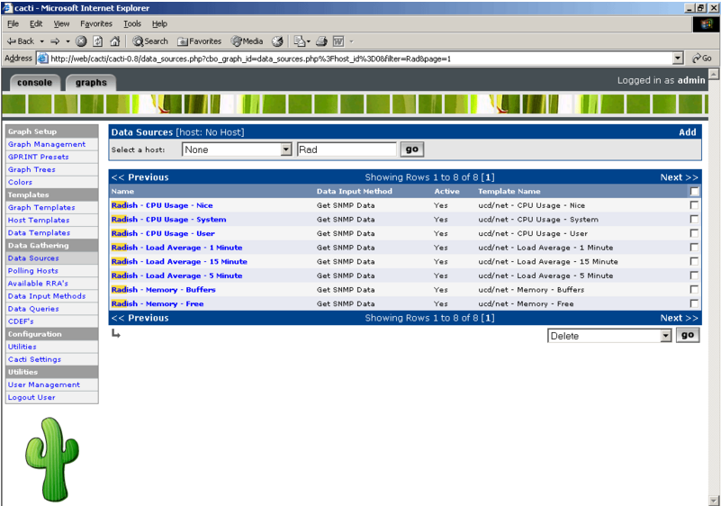
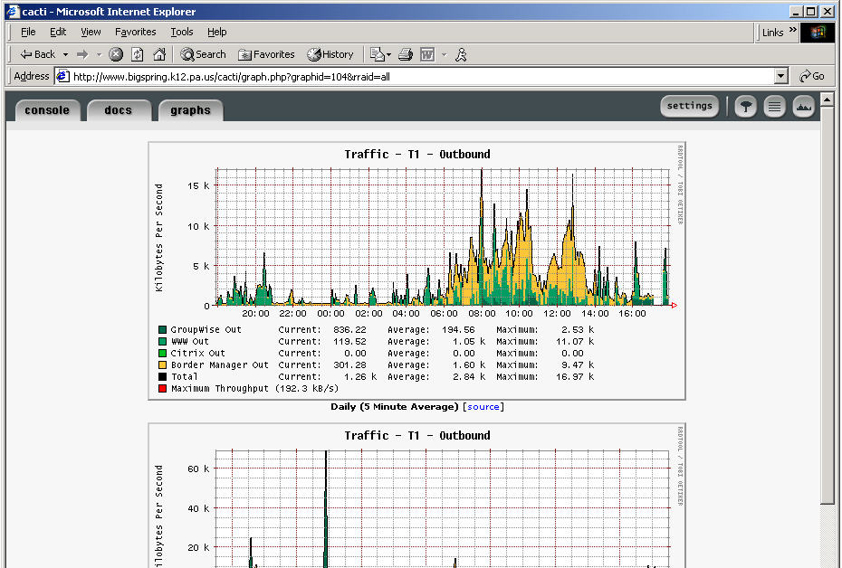
Some Early Screen Shots (Holy crap Batman!)

Slide 8
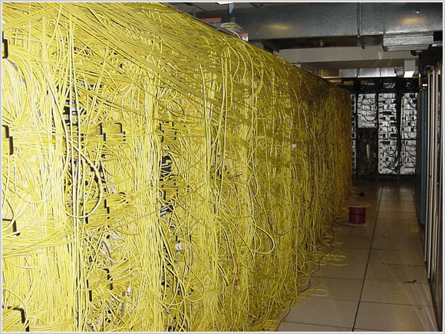
The Classic Network Operations Model

Slide 9
The Classical Network Operations Model
ault Management
F
C
A
P
S
onfiguration Management
ccounting Management
FCAPS is the ISO Telecommunications Management Network model and framework for network management
erformance Management
ecurity Management

Slide 10
Introducing the Plugin Architecture
The Cacti Plugin Architecture is a development framework that allows Cacti functionality to be extended
It was derived from the Squirrel Mail Project. Its original author, Jimmy Conner, created it so that Cacti could be extended beyond Performance Management
It is implemented through a series of ‘hooks’ within the Cacti core
Each ‘Plugin’ can use any of these hooks

Slide 11
Public Domain Cacti Plugin Examples

Slide 12
Some Popular Public Domain Cacti Plugins
Boost – Cacti Performance Booster
THold – Cacti Thresholding and Alarming
MacTrack – IP/MAC Tracking
WeatherMap – Interactive Network Topology Maps for Cacti
SuperLinks – Cacti UI Extension Framework
Nectar – Cacti E-Mail Reporting Tool
Realtime – Realtime Graph Tool
Syslog – System Log Alarming and Tracking Tool
HMIB – Cacti Host Resources MIB Reporting Tool
ConfigManager – Router Config Management Tool
Discovery – Network Discovery Tool
Monitor – Host Dashboard Tool
Autom8 – Graph and Tree Automation Tool
ReportIt – Cacti Top X Reports

Slide 13
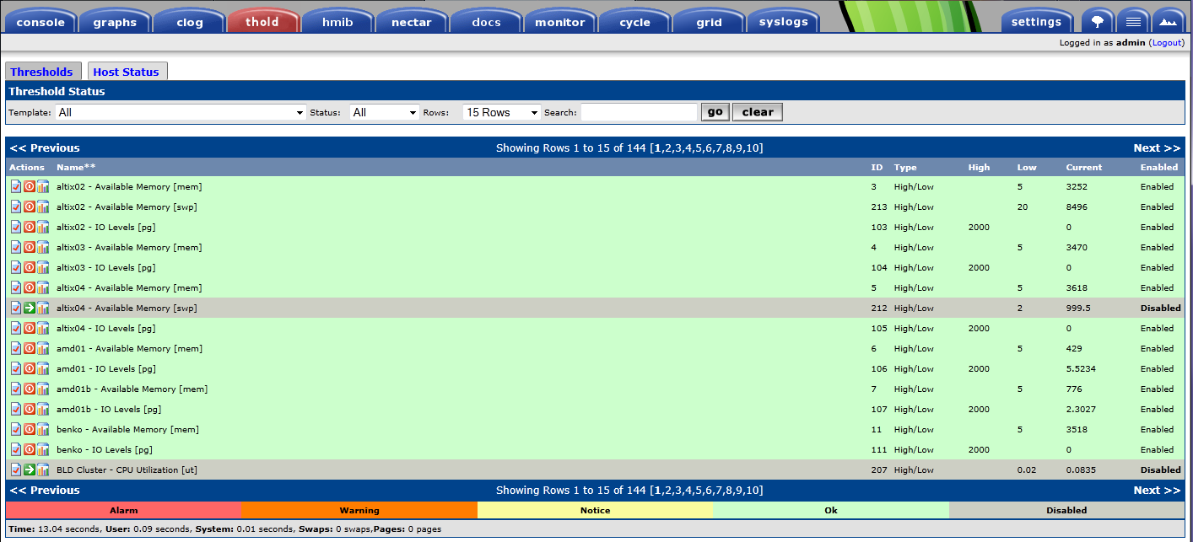
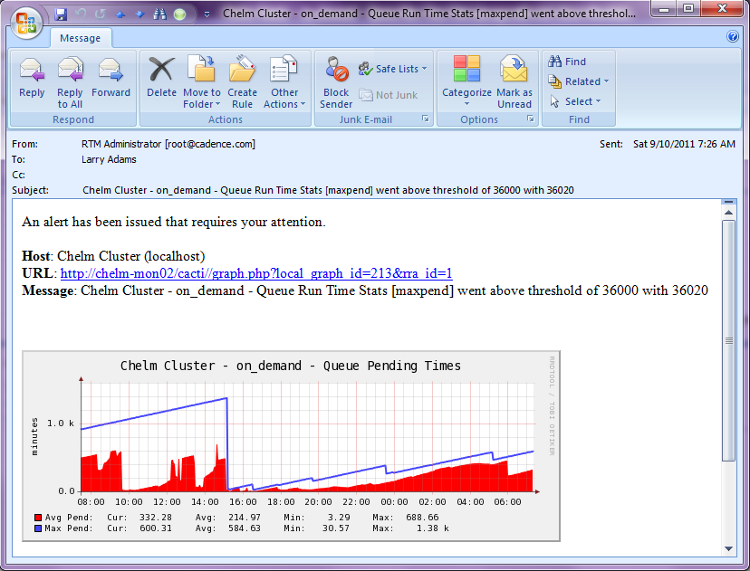
Cacti Plugins by Example - THold

Slide 14
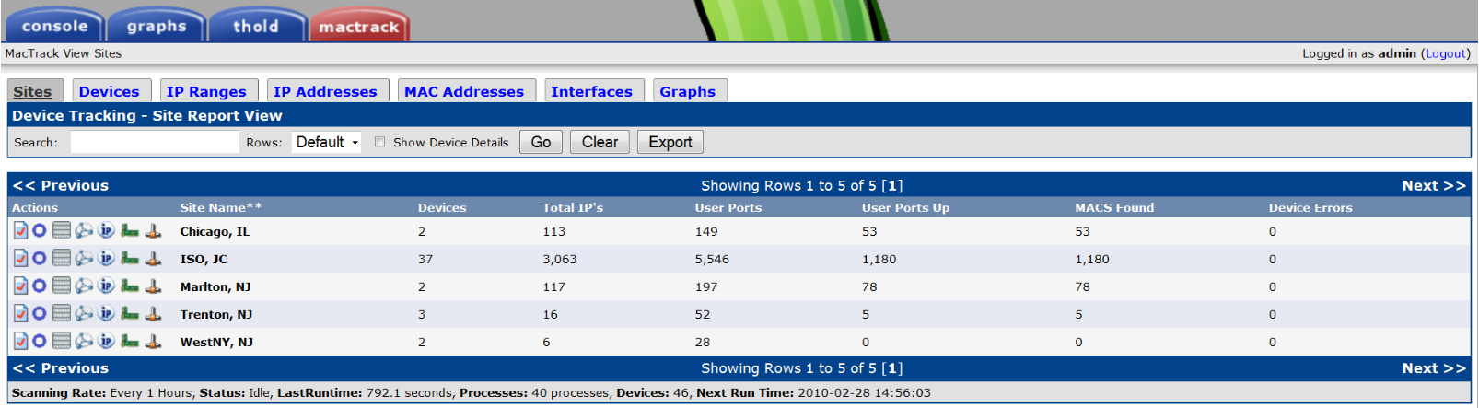
Cacti Plugins by Example – MacTrack

Slide 15
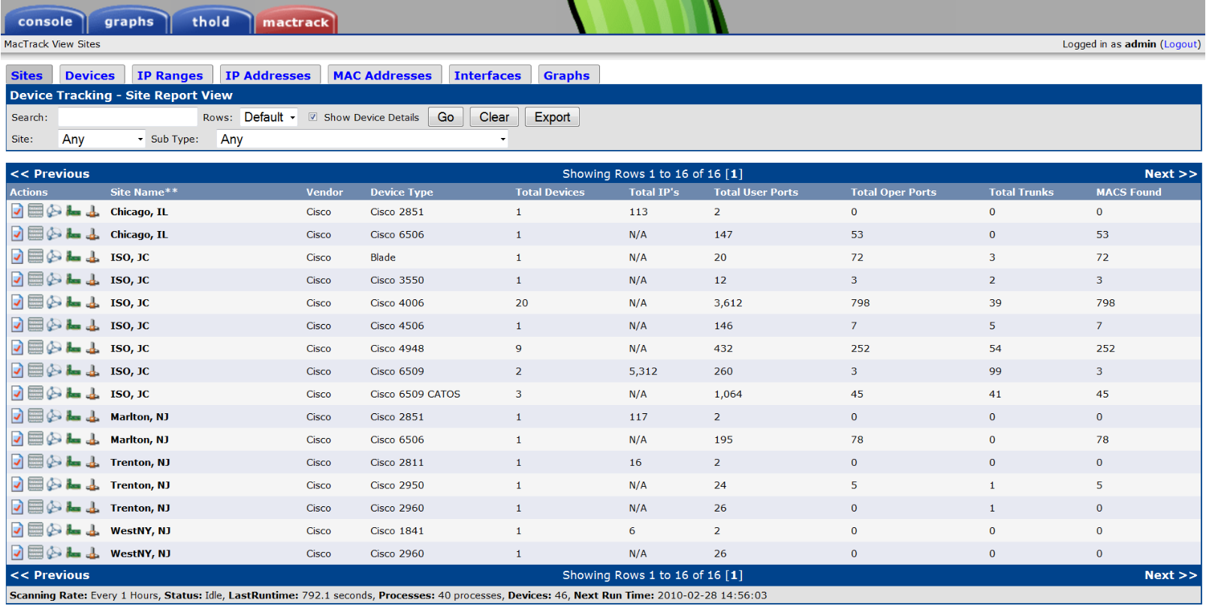
Cacti Plugins by Example – MacTrack

Slide 16
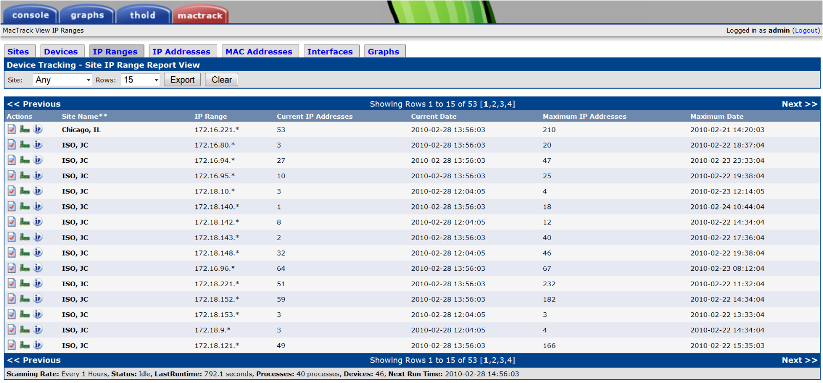
Cacti Plugins by Example – MacTrack

Slide 17
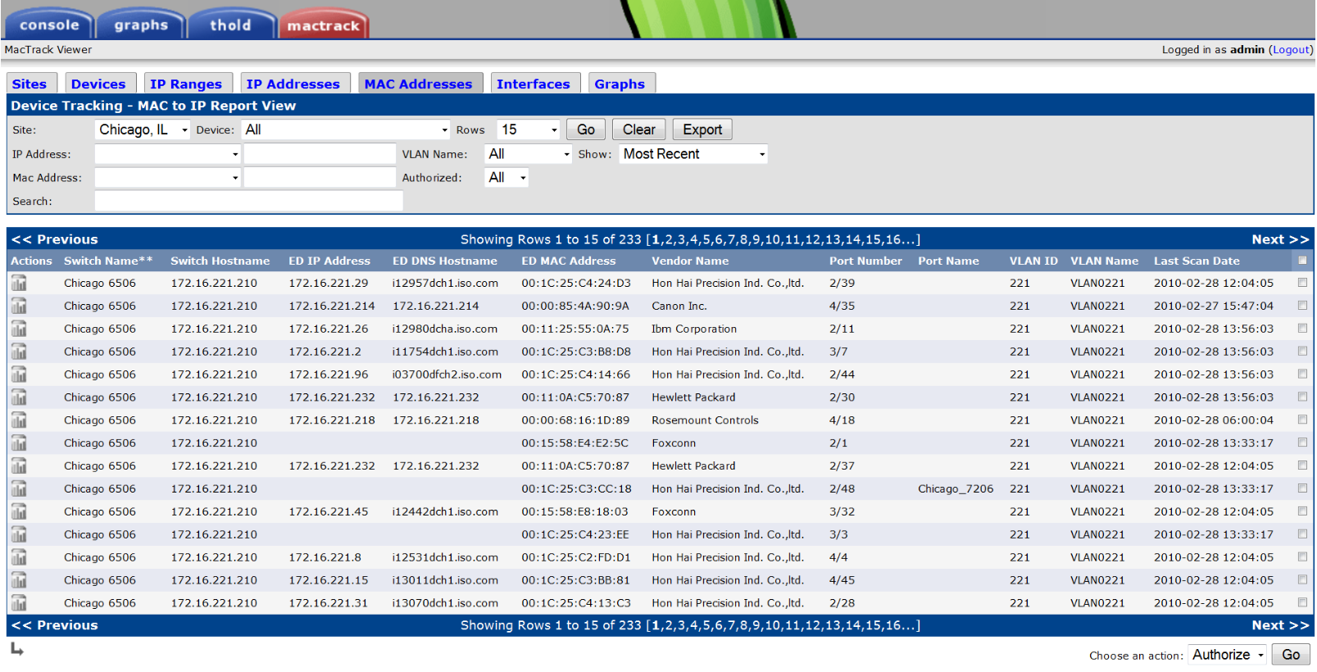
Cacti Plugins by Example – MacTrack

Slide 18
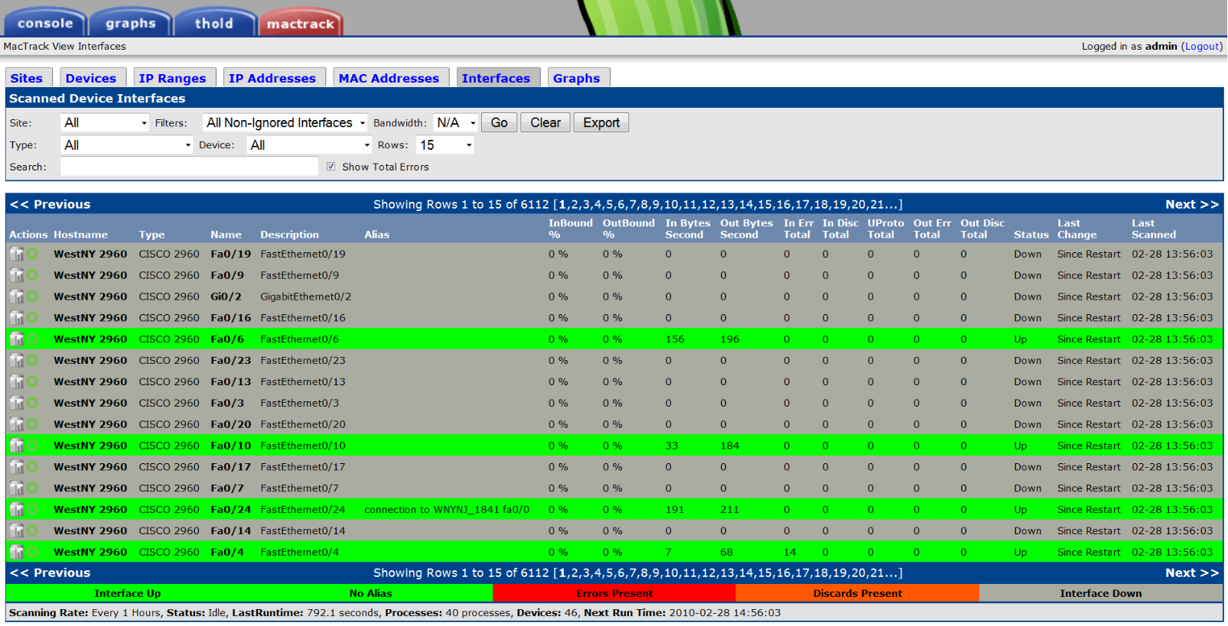
Cacti Plugins by Example – MacTrack

Slide 19
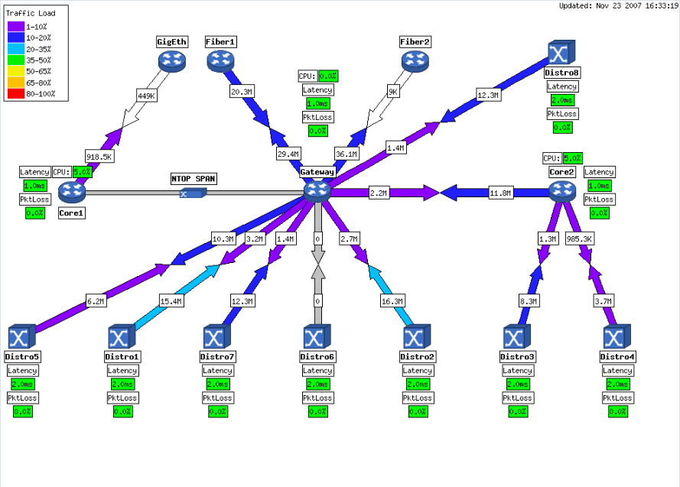
Cacti Plugins by Example – WeatherMap

Slide 20
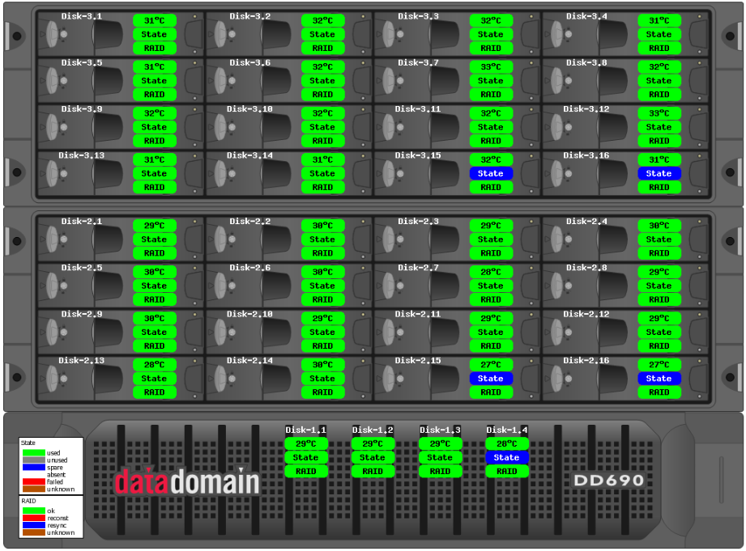
Cacti Plugins by Example – WeatherMap

Slide 21
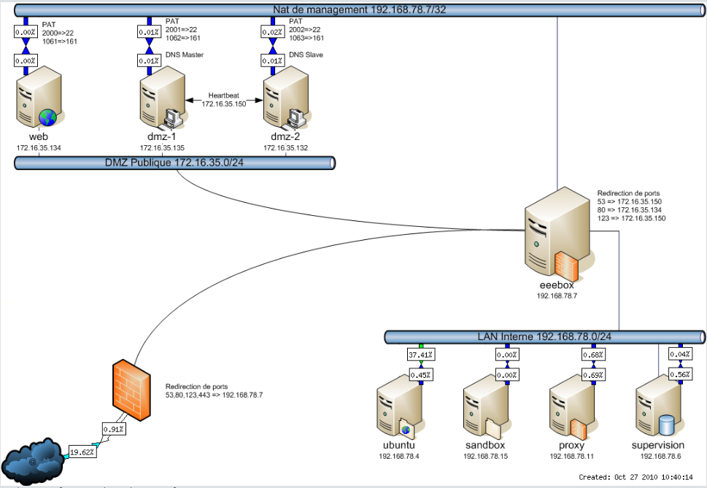
Cacti Plugins by Example – WeatherMap

Slide 22
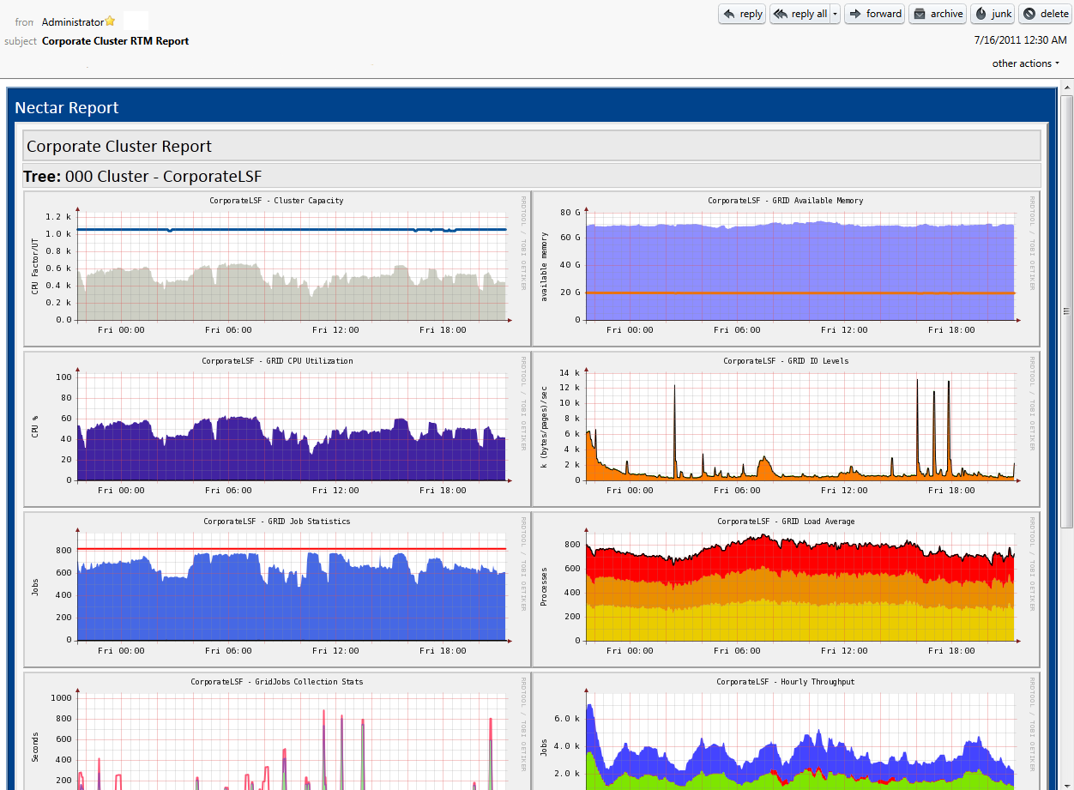
Cacti Plugins by Example – Nectar

Slide 23
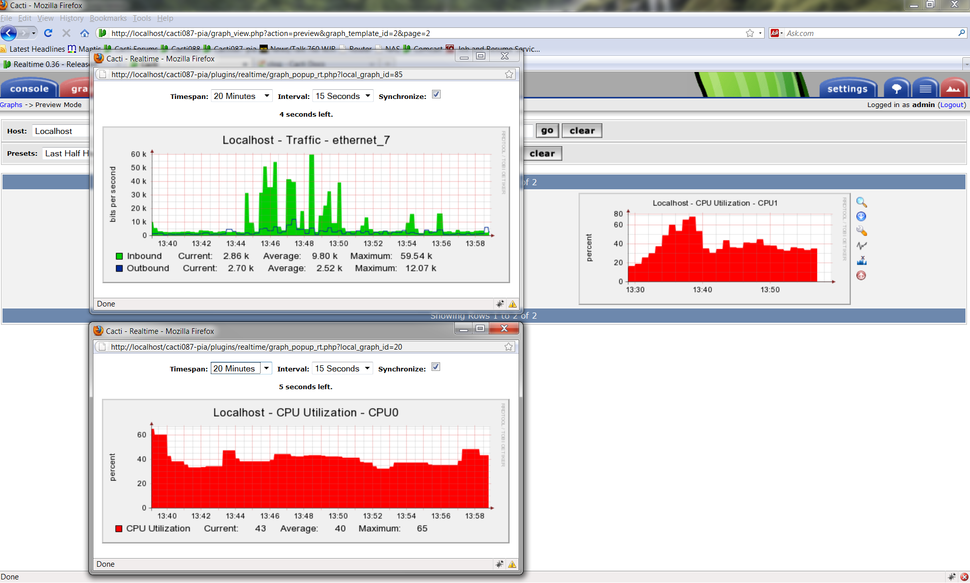
Cacti Plugins by Example – Realtime

Slide 24
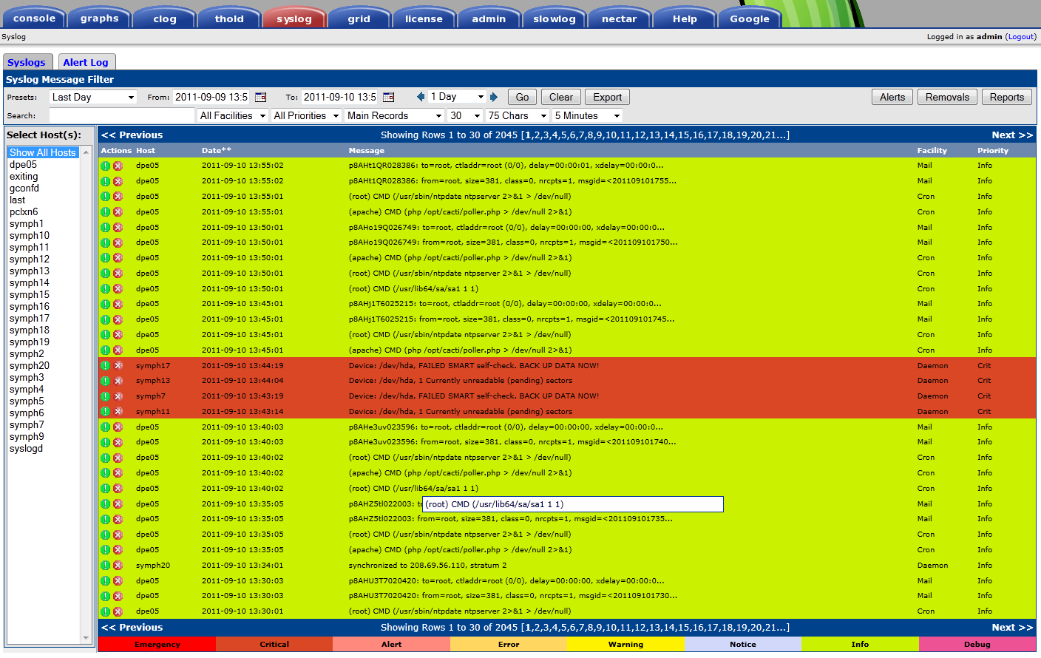
Cacti Plugins by Example – Syslog

Slide 25
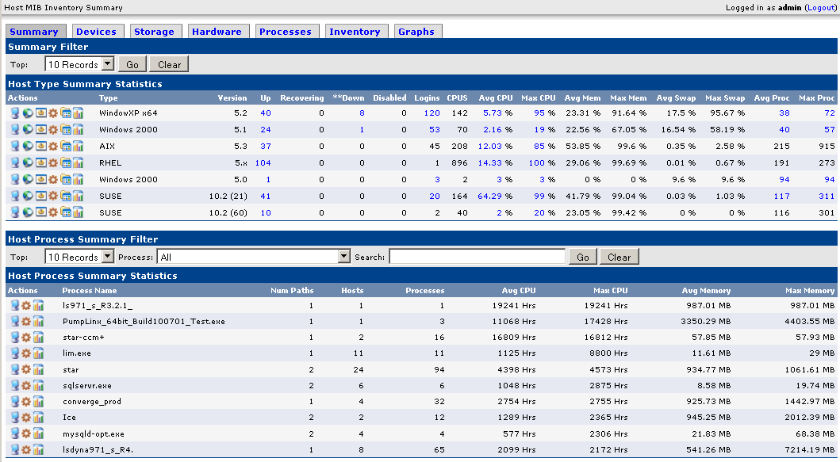
Cacti Plugins by Example - HMIB

Slide 26
Additional Commercial Cacti Plugin Examples

Slide 27
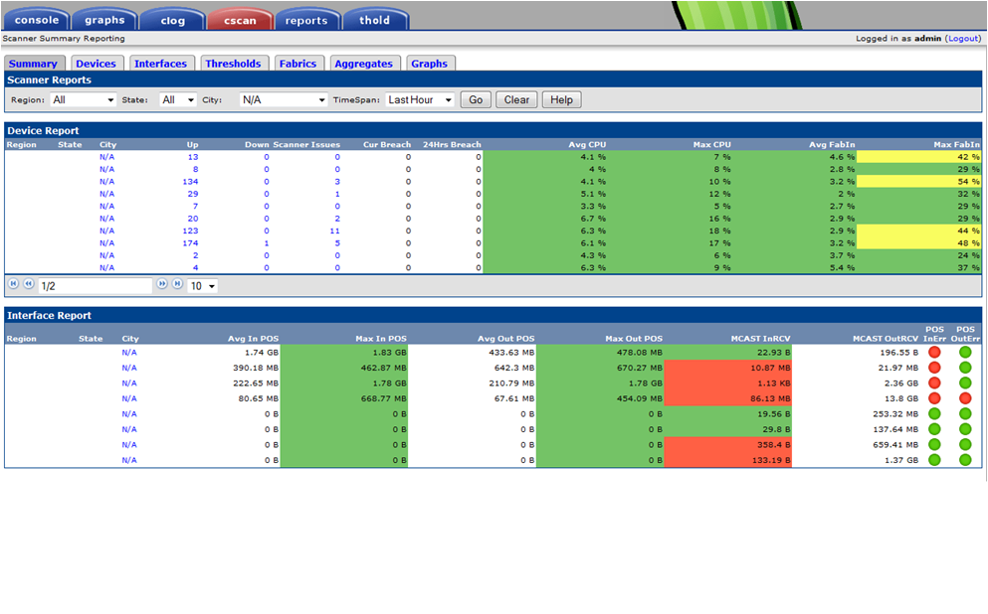
Scanner – ISP Network Management Uber Tool

Slide 28
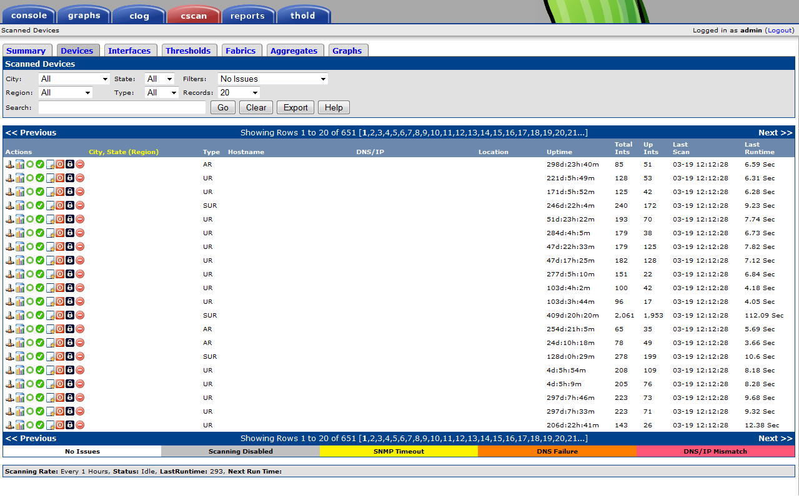
Scanner – Device Interface

Slide 29
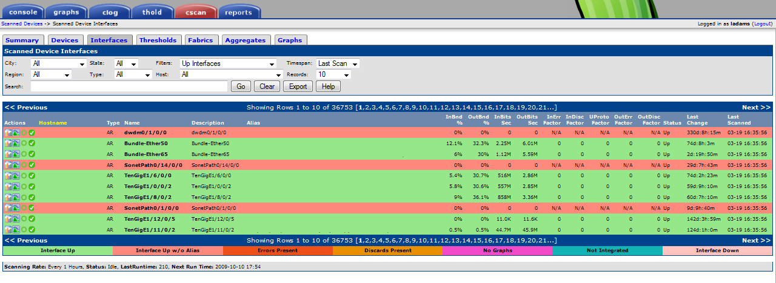
Scanner – Interfaces

Slide 30
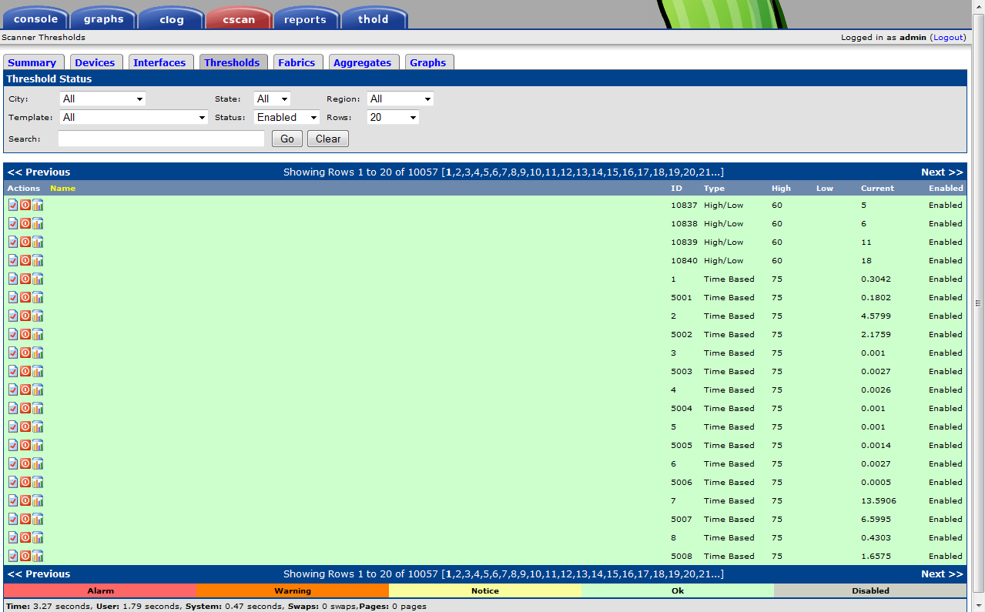
Scanner – Thresholds

Slide 31
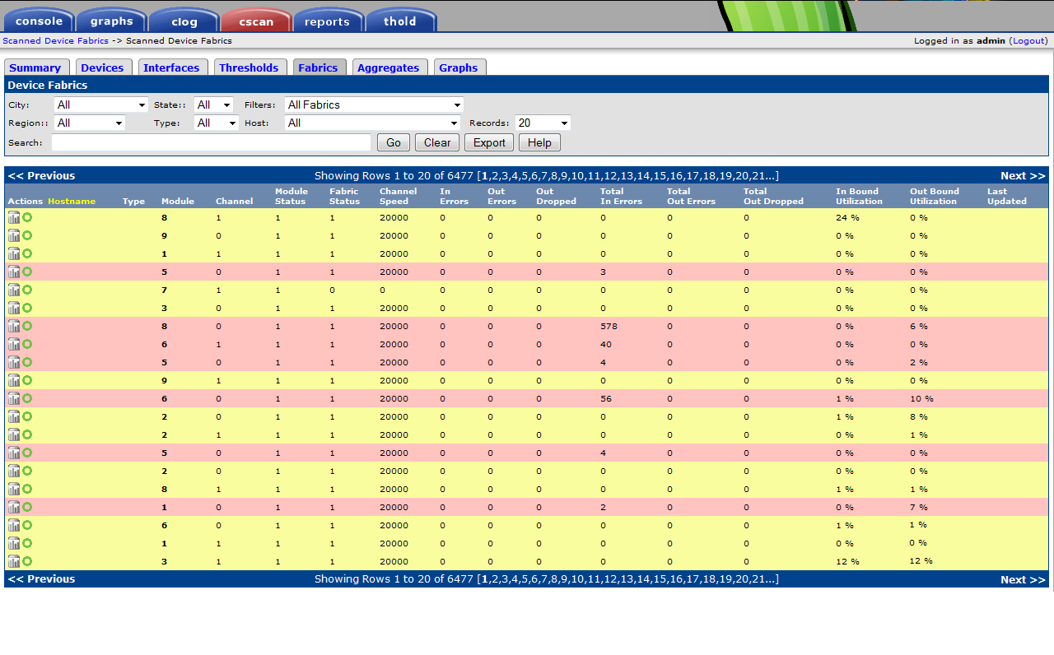
Scanner – Fabrics

Slide 32
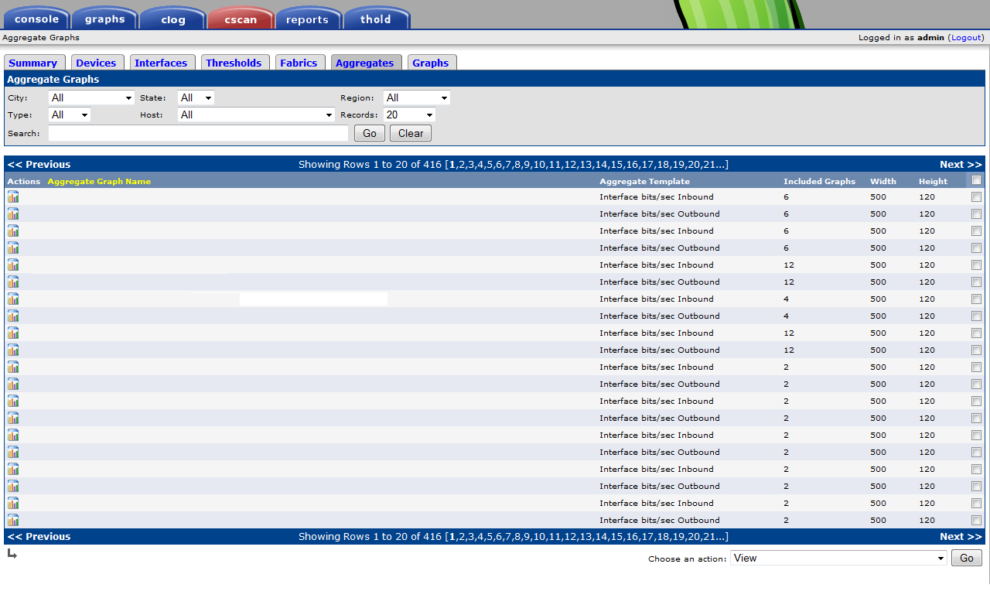
Scanner – Aggregate Graphs

Slide 33
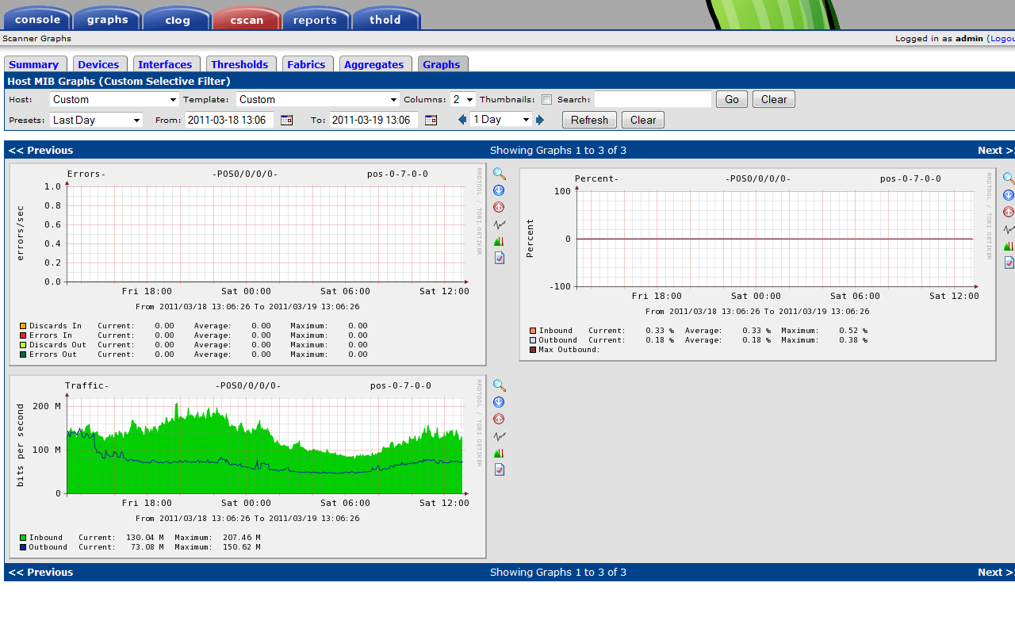
Scanner – Graphs

Slide 34
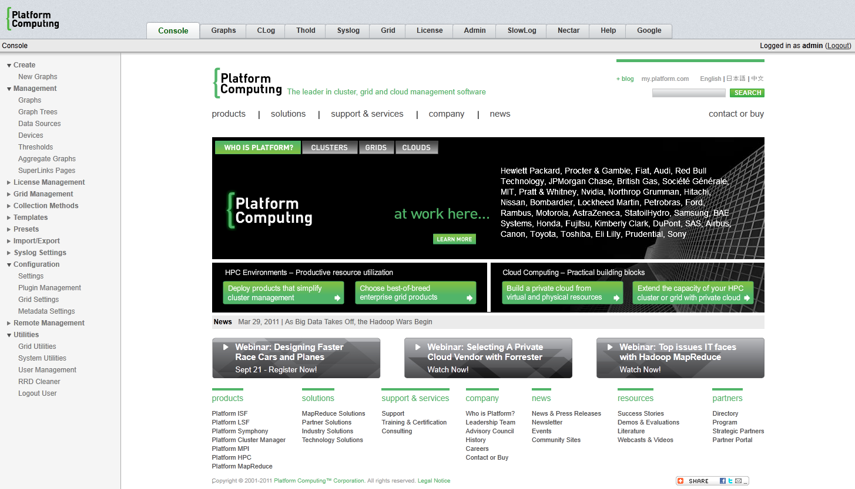
Platform RTM – The Grid Computing War Horse

Slide 35
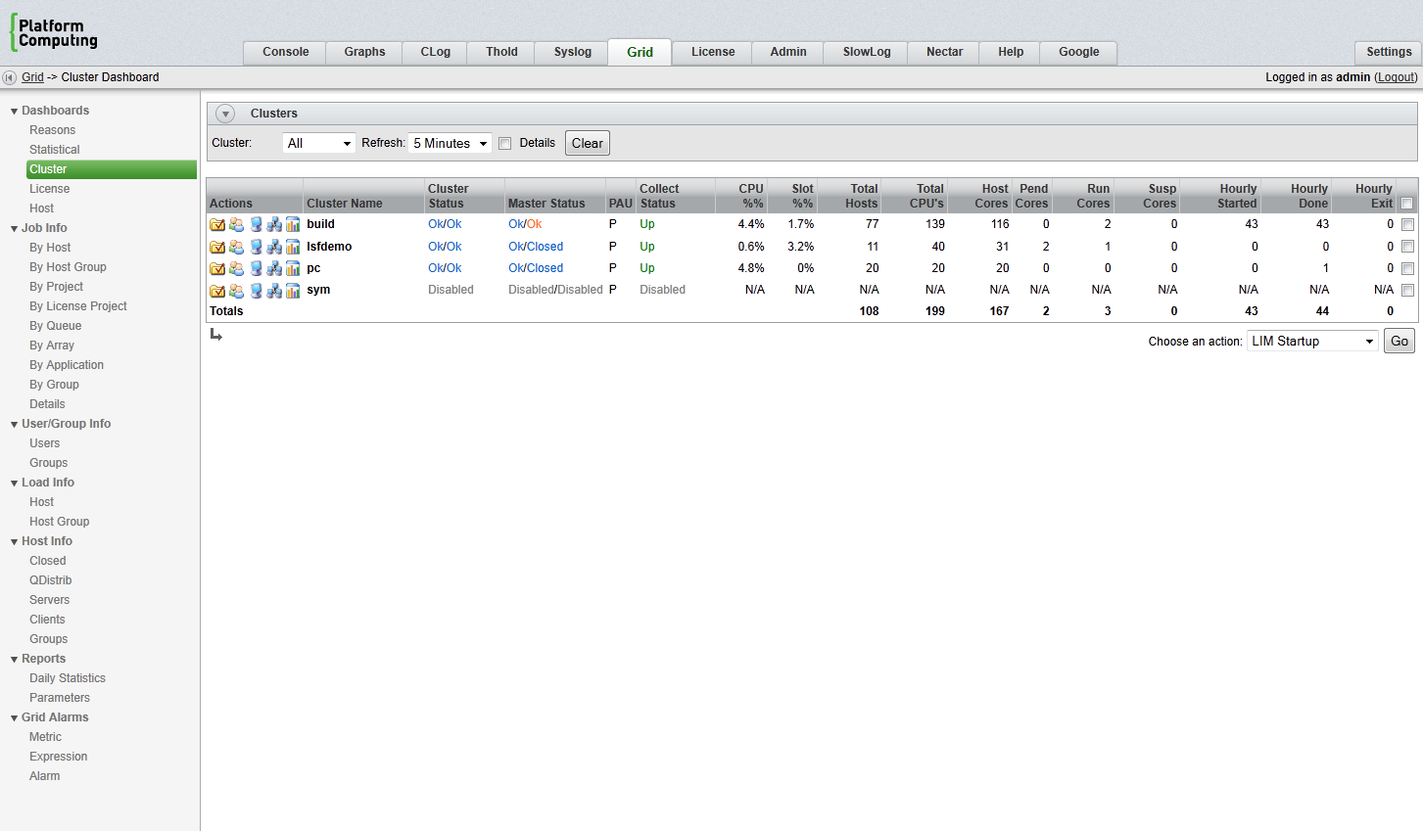
Platform RTM – Cluster Dashboard

Slide 36
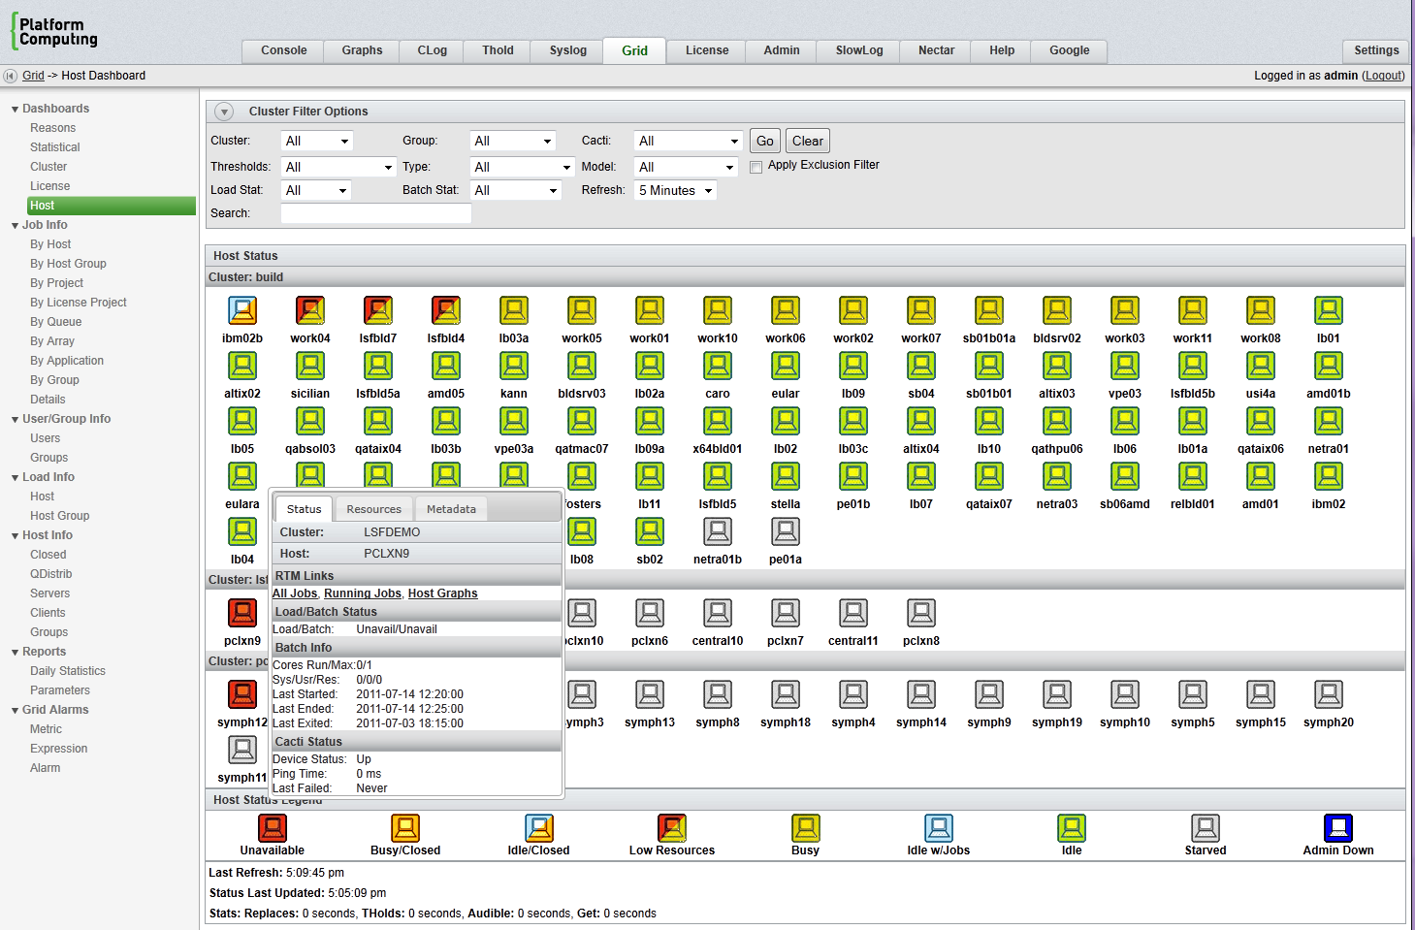
Platform RTM – Host Dashboard

Slide 37
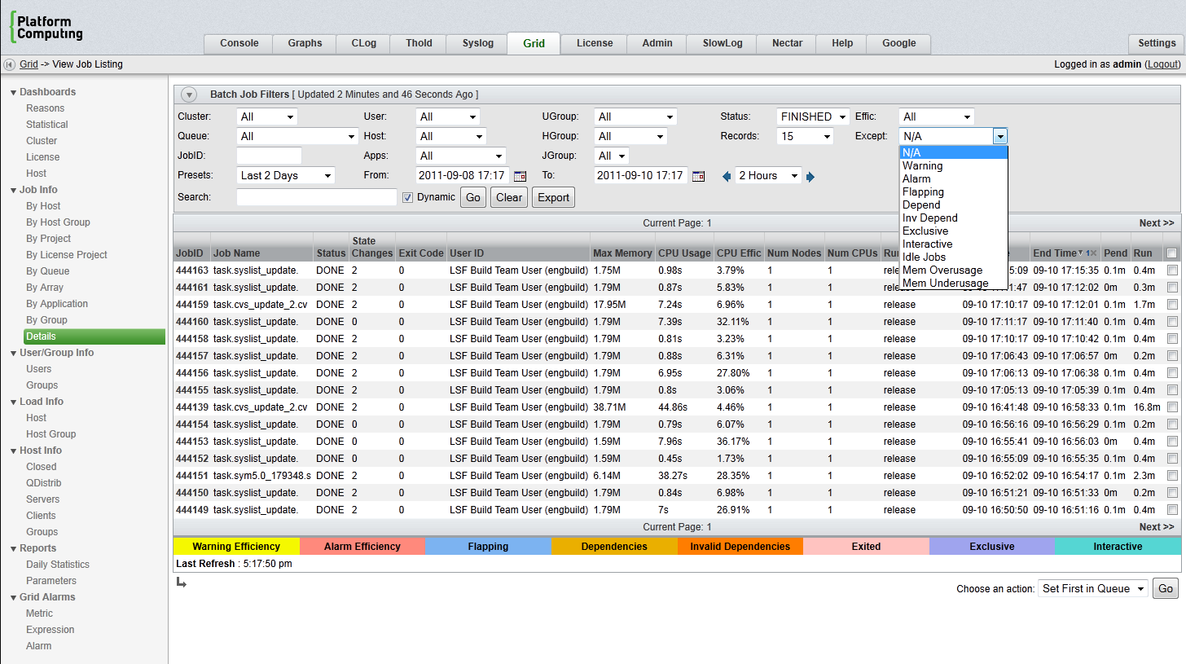
Platform RTM – Finished Job Details

Slide 38
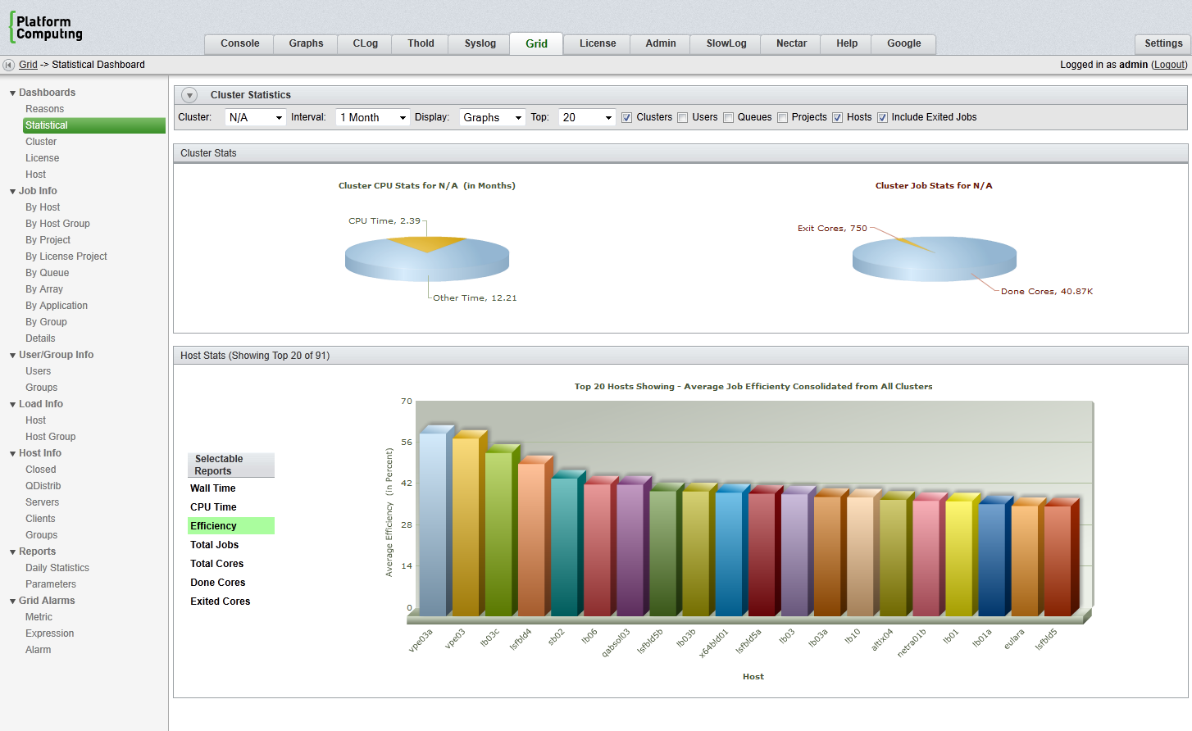
Platform RTM – Statistical Dashboard

Slide 39
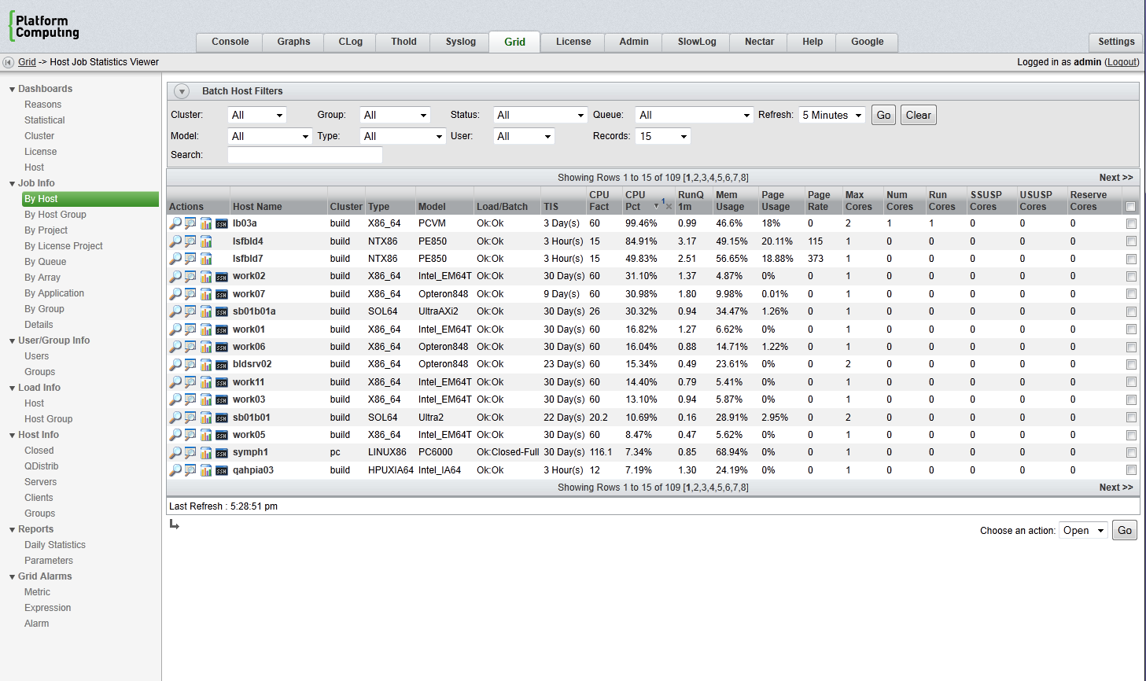
Platform RTM – Host Details

Slide 40
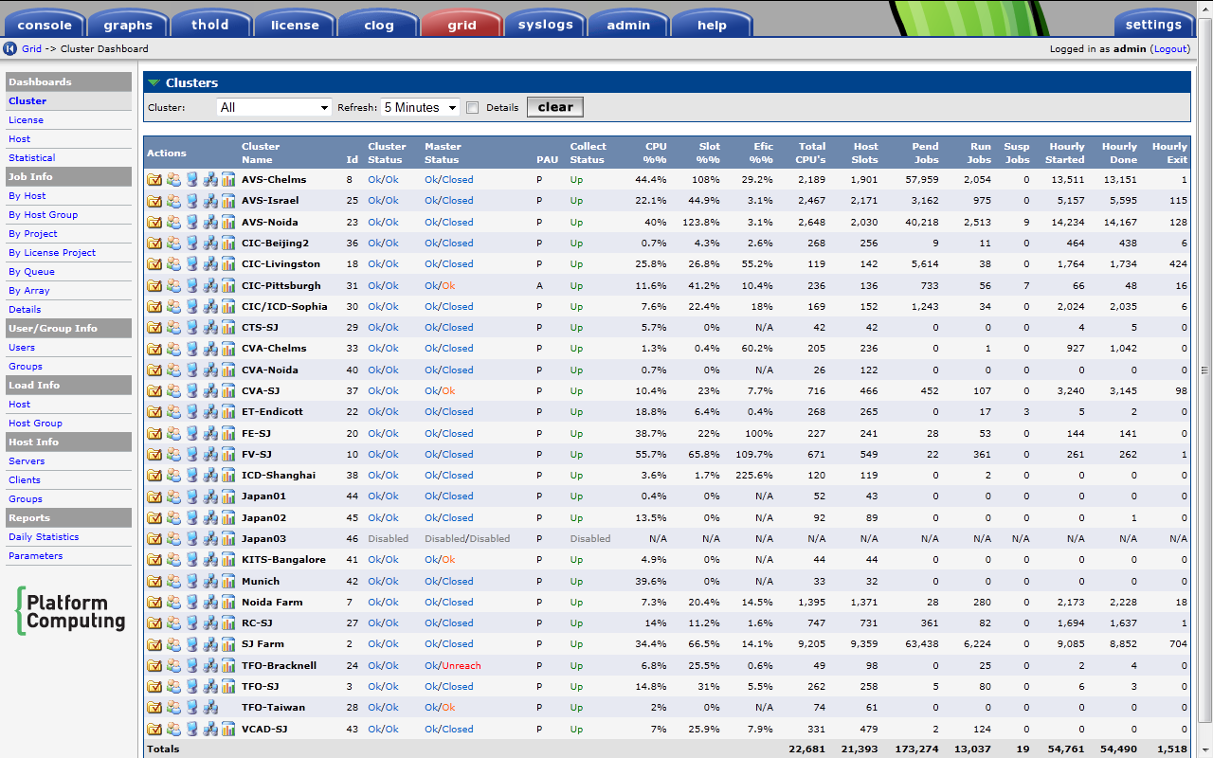
RTM – Host Dashboard 4k+ Hosts/4 Continents

Slide 41
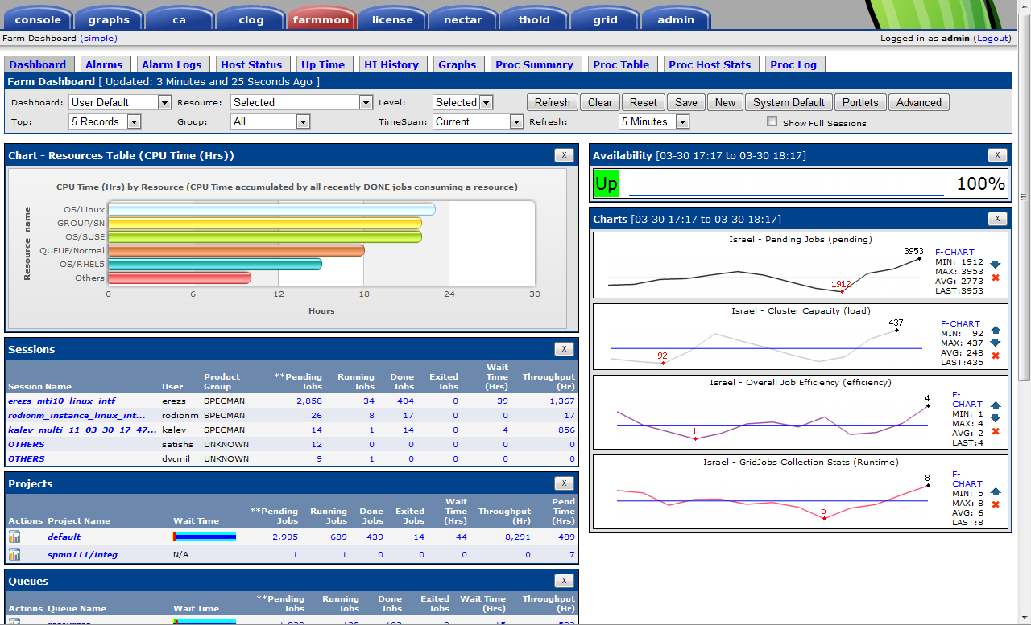
Farmmon – Dashboard

Slide 42
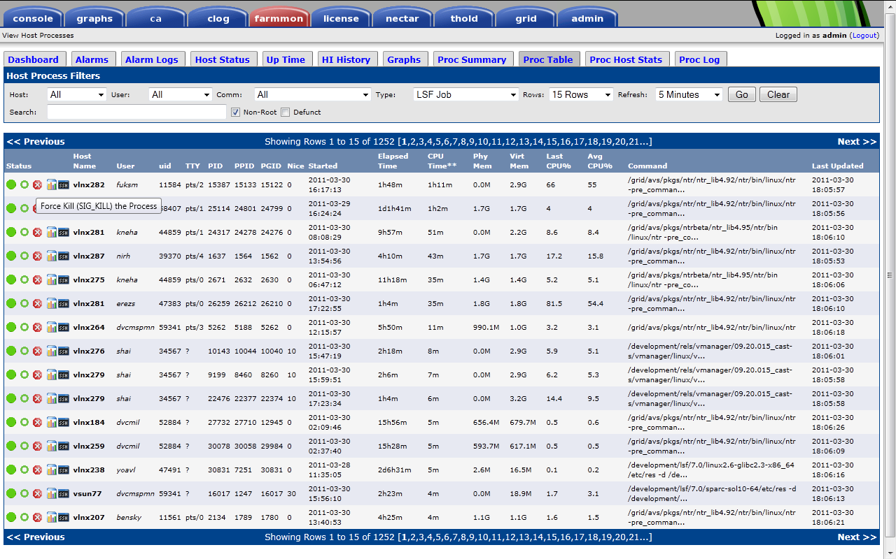
Process Status – Process List

Slide 43
The State of and Future of Cacti

Slide 44
Current State of Cacti
The Cacti Group is Alive and Well
Release of 0.8.7h Released
  Lossless Re-Indexing
  Poller Performance Increases
  Additional Template Import Options
  RRDTool 1.4.x Support
  Improved Spine Performance
  Per Host Parallelization Support
Everyone is busy with their day Jobs

Slide 45
The Future of Cacti
Development of Next Version Near Alpha Quality
  200+ Commits by All Developers in August
  Site Support
  Internationalization (i18n)
  Multiple Time Zone Support
  Integrated Plugin Architecture
  Large Site Performance Improvements
  Heavy CSS & Ajax Callback Support

Slide 46
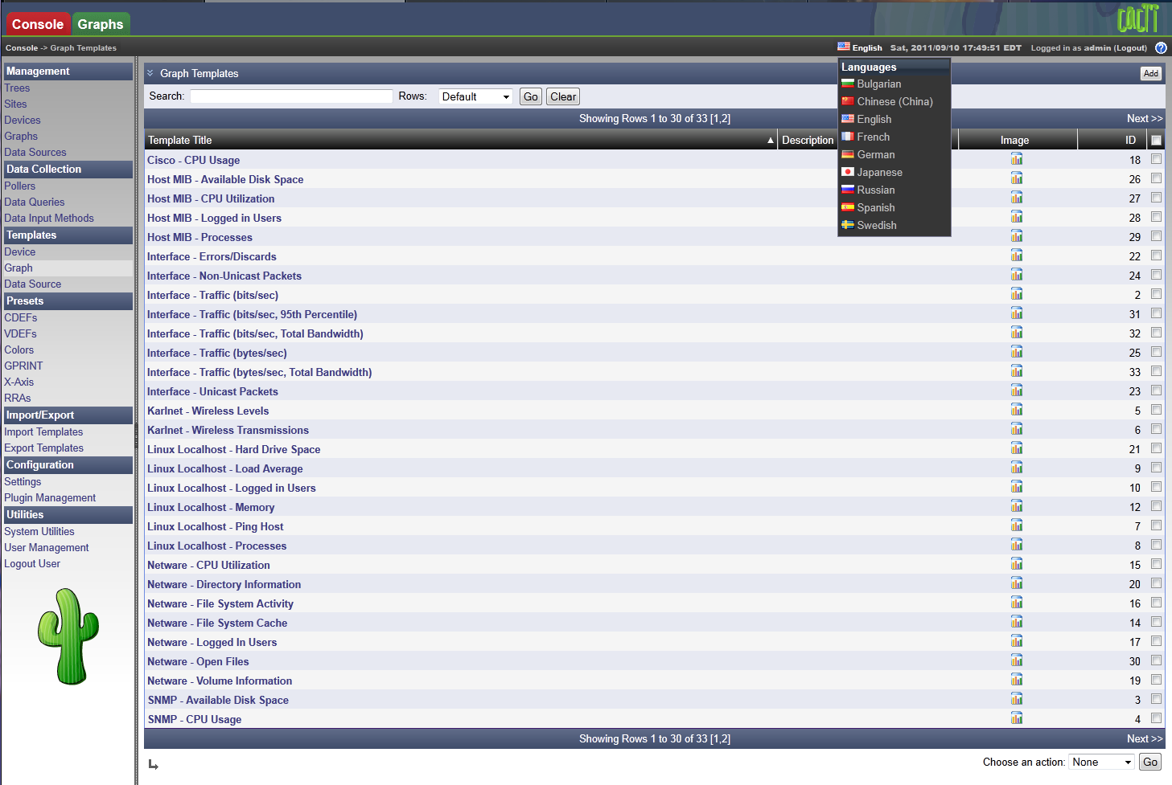
Cacti 1.0.0 – Teaser

Slide 47
Questions and Answers
Live is an Adventure. Let yours begin with Cacti

